Slide 1
The Observation & Review of Activation by Coupling of Phonon-Electron within Occupied Trap 20240930 진명

Slide 2

Conduction Band Direct Tunneling
지난 이탈리아에서의 교수님의 tip…
BETOX Nitride Region
Conduction band의 전자는
Direct tunneling의 확률이
Lateral spreading의 확률보다 현저히 낮음.
Conduction band로 activation된 전자는 모두 spreading만 일어난다.
>> Detrap 분석은 TBT만 해도 충분
High Vertical Electrical Field
(CTN charge)

Slide 3
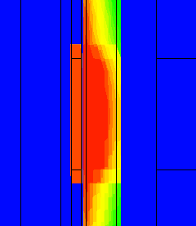
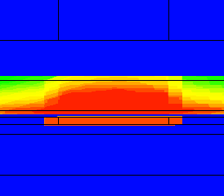
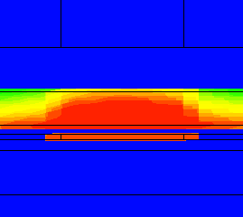
Trap to Band Tunneling Emission Observation
TCAD Simulation : BETOX region lock + 1us program
BETOX EOT = 4.2nm = 2/2/0.9 , 2/1.5/1.225 , 2/1/1.55
Region lock 이유
… Lateral Spreading within BETOX
WL
Box
CTN
BETOX
Channel
Filler
2/2/0.9 [nm]
2/1.5/0.9 [nm]
2/2/0.9 [nm]

Slide 4
Trap to Band Tunneling Emission Observation
Time constant observation ($τ$) >> stretched-exponential function fitting
0.8eV, 2/1.5/1.225 case transient response
High Temperature
Low Temperature
: Higher temperature, faster TBT
0.6eV, Mid-BETOX 2, 1.5, 1[nm] case
: Thinner trap site, $β →1$
$$β_{2nm}<β_{1.5nm}<β_{1nm}$$

Slide 5
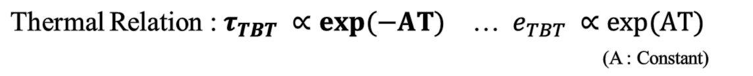
Trap to Band Tunneling Emission Observation
Thermal Relation : $τ_{TBT} ∝exp⁡(−AT)$ … $e_{TBT} ∝exp⁡(AT)$
(A : Constant)
Sufficient trap site
Sufficient trap site
Low trap site
Low trap site
… $τ_{TBT}$ has thermal relation within attempt-to-escape frequency
(⸪ Transmission coefficient has no temperature parameter)

Slide 6
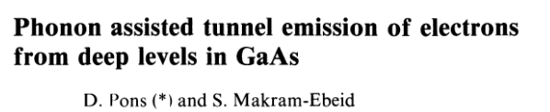
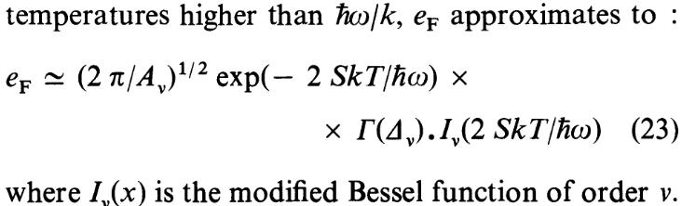
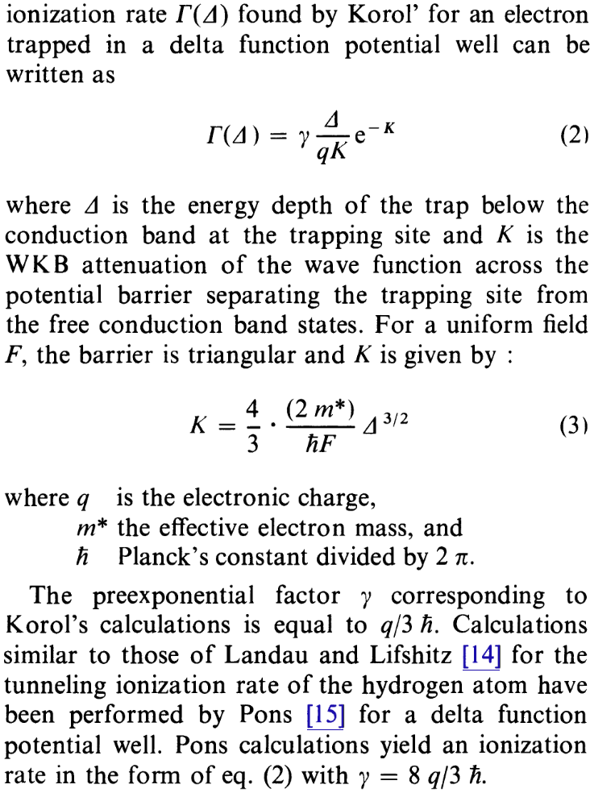
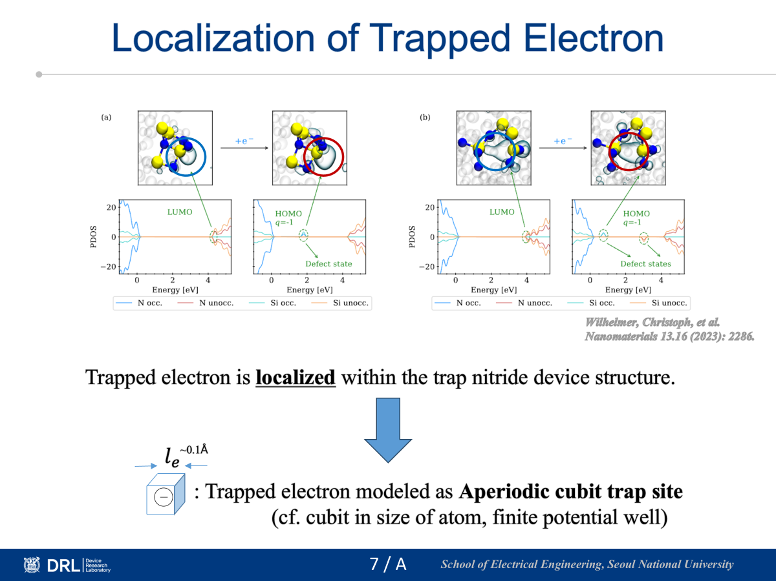
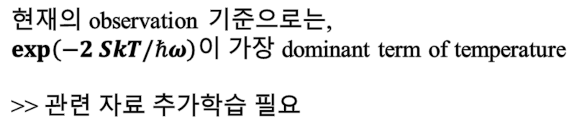
References for TBT – Temperature Relation
현재의 observation 기준으로는,
$\exp\left(−2 SkT/ℏω\right)$이 가장 dominant term of temperature
>> 관련 자료 추가학습 필요
8월 자료 中
localization of Trapped electron과 동일한 아이디어
>> 동일선상의 모델링
Pons, D., Journal de Physique 40.12 (1979): 1161-1172.

Slide 7
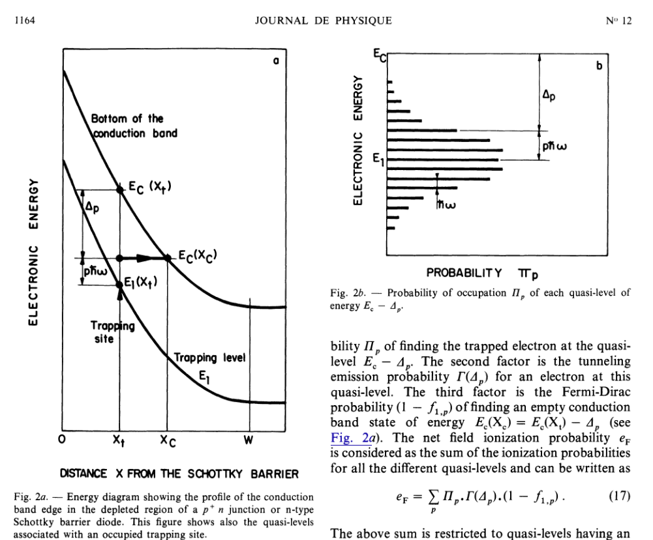
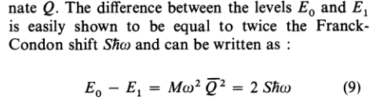


References for TBT – Temperature Relation
Fermi-Dirac Distribution
(maximum state of trapped electron)
$${Δε}_{B}$$
$ε_{t}$
Trap to Band Tunneling
(ground state of trapped electron)
Ground state – maximum occupied level
>> phonon assisted energy로 인한 activation이 주는 energy level enhancement가 핵심적인 역할
Pons, D., Journal de Physique 40.12 (1979): 1161-1172.

Slide 8

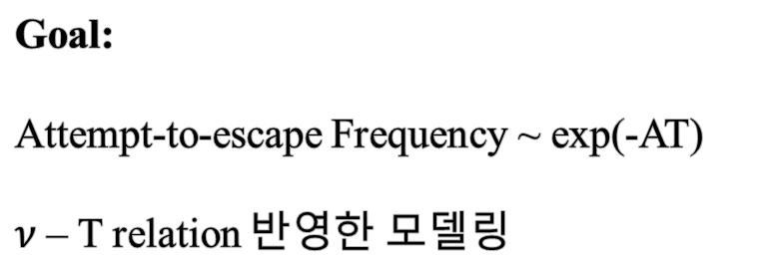

Future Works
해당 논문기준의 Field-induced ionization에 대한 리뷰 철저하게 진행
Fermi-Dirac Distribution
(maximum state of trapped electron)
Goal:
Attempt-to-escape Frequency ~ exp(-AT)
$ν$ – T relation 반영한 모델링
$${Δε}_{B}$$
$ε_{t}$
Trap to Band Tunneling
(ground state of trapped electron)

